Slide 1
Global Europe Instrument
=
NDICI Regulation
Neighbourhood, Development and International Cooperation Instrument
PARTOS 30 June 2022

Slide 2
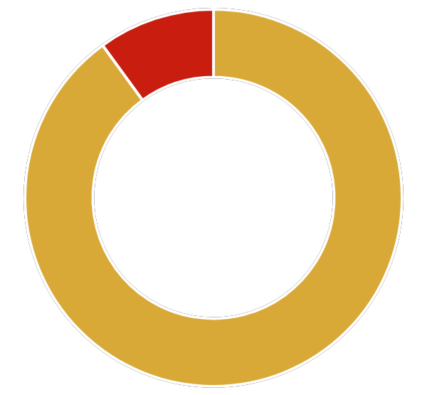
EU Budget 2021-2027 (MFF)
basics
In External Action, Global Europe Instrument = 79.4 €b (current prices)
geographical programmes (country level) with almost 75% of funds,
thematic programmes,
rapid-response actions,
reserve to be used in a more flexible manner
HAid
IPA
CFSP
9.2%
External heading

Slide 3
Context for this new instrument
EU is a top global donor, primary trade and investment partner for many countries
Added value: competence and expertise, geographic range, credibility as a peace player, economic clout...
External action budget serves to promote EU values and interests in the world
Shift from development cooperation to international partnerships
Geo - political priorities of the Commission
Policy commitments: Agenda 2030, European Consensus on Development, EU Action Plan on Human Rights and Democracy, EU Gender Action Plan III, EU-Africa Strategy….

Slide 4
Context: Overarching geopolitical priorities
of the new Commission
Growth and jobs
Digitalisation and data technologies
Governance, Peace, Security and Stability
Green Deal
Migration Partnership

Slide 5

GEI architecture and figures - €79.4bn
Geographic (75% - 60.388 bn)
Neighbourhood (@least 19.3bn)
Sub-Saharan Africa (@least 29.12bn)
Asia and the Pacific (8.489 bn including @least 500mio for P)
Americas and the Caribbean (3.395bn @least 800 mio for C)
Thematic (6.358bn)
Human Rights and Democracy (1.362bn)
Civil Society Organisations (1.362bn)
Stability and Peace (908mio)
Global Challenges(2.72bn)
Rapid response (3.182bn)
Crisis Response and Conflict Prevention
Resilience and linking humanitarian and development actions
Foreign policy needs and priorities
Emerging challenges and priorities cushion (9.534bn)
Investments

Slide 6
Main features new instrument
1 instrument combining features of more than 11 previous instruments
Geographisation
  Strategic focus on Africa and Neighbourhood
  Wider geographic scope widened for strategic partnerships (including higher-income countries)
  Cross-cutting priorities (the geopolitical priorities: migration, Digitalisation, Green Deal, Growth and Jobs,Governance Peace and Security)
Flexibility and simplicity
  Flexibility within and between programmes (10-15%)
Oversight - EDF budgeted = EP scrutiny, increased accountability and predictability
More blended finance

Slide 7
Global Europe figures - other details in final agreement
1bn additional to be transferred from cushion for thematic programmes:
  200 mio for human rights and democracy
  200 mio for CSOs programme
  600 mio for Global Challenges
Local Authorities (500mio indicative amount under geographic programmes)
Erasmus (1.8bn indicative amount under geographic programmes)

Slide 8
Some novelties
Implications of EDF ‘budgetisation’
  ‘Winners and losers’ in terms of regions?
  The focus of cooperation continues to shift towards Africa and the Neighbourhood, although a minimum budget for different regions (caribbean, pacific) is ensured.
Changes in the partner country role
  While development effectiveness principles remain a commitment in the NDICI, and alignment with country priorities should be ensured, compared with EDF programming processes, the country ownership is weakened.
Article 30 - Carry overs...

Slide 9
Global Europe - programming
MIPs/Regional MIPs
  Multi-year strategic document, with mid-term review
  EUDs responsible for ensuring multi-stakeholder consultation
  Strategic exchange with EP and MS
  Approval by MS Committee
EC prepared 2021 Annual Action Plans for each programme
  Actions to be financed outlined in annexes to AAP
Joint programming with MS and agencies/IFIs: joint analysis and response leading to multi-annual programming based on country priorities
NEW: Team Europe, an approach born in COVID times
  Includes Team Europe Initiatives - flagships with common branding
Notes:
TE: pooling of resources with a view to promote EU values through external action as well as incr efficiency =closer collaboration between EU MS and institutions as well as development banks. Increasing importance of MS agencies in setting EU programme priorities in country, particularly through TEIs which they will co-lead and co-fund as well as co-developing
2-3 TEIs per country and region, but looks like more in regional programmes

Slide 10
Geographic - Programming timeline
Pre-programming
Programming
Approval
March - July 2020.
EU Delegations organised consultations and finalised their proposed “Team Europe” initiatives.
November 2020-September 2021
Defining detailed modality and priority of aid for the country
Drafting of Multi-annual indicative programmes (MIPs) with consultations in partner countries and Brussels
October-November 2021
Finalisation of the programming process by approval of the MIPs by EU Member States.
Notes:
Where we are now: The programming phase started in November 2020, consultations were held with CSOs at country level between November - March 2021, during which the EU was developing detailed priorities for each country or global thematic, as well as the TEIs and requesting CSOs inputs. Regional programme consultations have been happening in Brussels since March 2021 and Concord and some members have been able to partiicpate and coordinate inputs in person and in writing for each consultation. The work has been led by the regional/ thematic focal point groups.
The EUDs are also working on which actors or funding modality are best placed to achieve the expected impact.
Analysis of the process:A The programming exercise should be an inclusive process encompassing broad and transparent consultations with different
stakeholders in the countries - including civil society. EU Delegations were able to choose how to manage these consultations in the most appropriate manner. Concord has been tracking the consultations, to ensure that its members and wider civil society were informed to participate, and feeding back on this to the EU in Brussels throughout the process to hold the EU to account on the inclusive consultations process. Although we found that Concord was able to support better access to the consultations, based on reports from countries not all processes were v meaningful and the whole process was quite rushed. Without further input on the MIPs it is questionable to what extent Civil Soc was able to really influence programmes. A strategic piece of work to analyse the process is planned before end of the year to be shared with the EC.
Approval: expected by the end of the year although EUDs are already able to launch certain aspects of the new programmes in line with Covid flexible procedures where deemed necessary in the particular country. There are ongoing regional consultations this week (LAC and the Southern neighbourhood) and there may be some ongoing in countries up to the summer. Concord has requested that EUDS share draft MIPs for further inputs, at least at regional level. However this has not been confirmed. We believe the next window of opportunity to influence this process may be through the public consultation to be held in June, while the EP has the opportunity to feedback on the sub-regional priorities in the MIPs (delegated acts).The EP continues to have a role in dialogue but not in the final approval process by the EC/MS.

Slide 11
Cross-cutting priorities
of the new Commission
Involving civil society, public and private sector and financial institutions
Increasing human
capital
Multilateralism and promotion of Partnerships
also a transversal priority.
Promoting gender equality and women’s empowerment
Programming guidelines put heavy accent on human development and inequalities too
Notes:
Part of the MIPs analysis to be done by the Programming group will be to focus on the balance of priorities and benchmarks
Human development benchmark was added later which is positive, but not seeing this reflected really well in the programmes so far

Slide 12
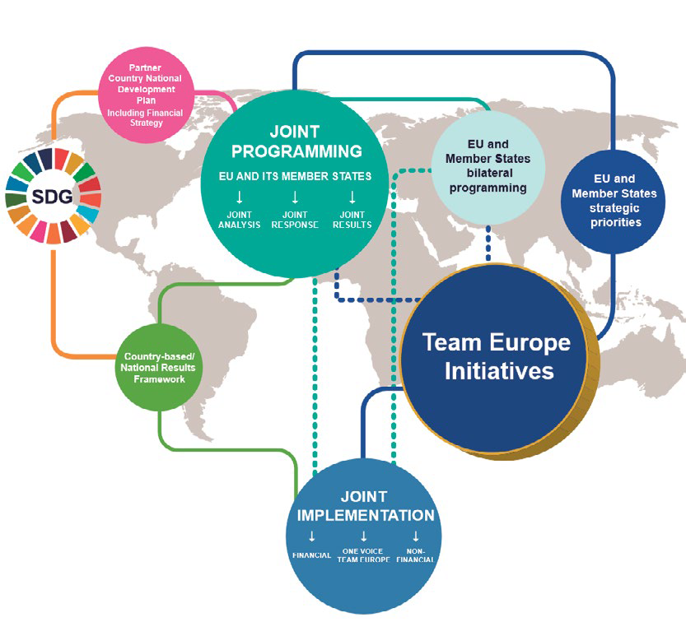
Team Europe Initiatives and Joint Programming

Slide 13
Global Europe -
Opportunities for CSOs
Open, transparent and regular dialogue with civil society
Policy Forum on Development
CSO involvement as a cross-cutting priority
Direct support to CSOs (Civil Society Programme and Human Rights and Democracy Programme)

Slide 14
Global Europe - CSO programme in final agreement
Total envelope: 1 562 000 000 for 7 years
Article 11- Scope of the thematic programmes
(b) Civil Society Organisations:
– Inclusive, participatory, empowered and independent civil society and democratic space in partner countries;
– Inclusive and open dialogue with and between civil society actors;
– Awareness, understanding, knowledge and engagement of European citizens regarding development issues. (DEAR programme)

Slide 15
Global Europe - modalities
Budget Support funding from the EU directly to governments.
Grants- financial donation given to a beneficiary (for example, the applying CSO) to contribute to the achievement of a policy objective by covering part of the functioning or project costs of the applicant.
Public procurement (tenders) usually for infrastructure projects, large-scale service provision,
Blending links EU budget grants with loans by international, regional, and European bilateral financial institutions (EIB, EBRD, CEB,...)

Slide 16
Global Europe - modalities
Opportunities for CSOs
Partnership Arrangements
Eligibility restricted calls for proposals: centrally managed
Eligibility restricted calls for proposals: locally managed
Direct awards
Financial Support to Third Parties

Slide 17
Key CONCORD achievements
Objectives and amounts
  93% ODA (binding), 0.7% and LDCs & fragile contexts
  Poverty reduction objectives, SDGs, Development effectiveness principles
  More than ⅓ for ACP countries
Targets
  At least 20% human development, GAP 3 targets (gender mainstreaming and targeted actions), 30% climate and indirect 5% biodiversity, 10% migration
EFSD+
  Capped at €10 billion, all elements of CONCORD ‘10 points’ taken on

Slide 18
Key CONCORD achievements cont’d
Human rights
  Specific programme, not requiring country consent
  Due diligence, business and HR mentioned
  Explicit that EU may not fund HR violations
Migration
  Improvement in language: more balance between mobility, forced displacement, protection, international law and irregular migration etc
  limit to the 10% conditionality - applicable to migration actions
Gender
  85% mainstreamed and 5% targetted (not funding but share of programmes)
  Gender equality, SRHR, gender mainstreaming, gender transformative and gender sensitive

Slide 19
Global Europe - adoption
Key CONCORD achievements cont’d
CSO
  Partnership and value mentioned throughout, meaningful involvement in programming
  CSO programme maintained, roadmaps mentioned
  Freedom of assembly and association specifically mentioned (shrinking space)
European Parliament voted in June 2021
Regulation applies retroactively from 1 January 2021.

