Slide 1
The IUCN standard for NbS (2020) lists 8 interrelated criteria providing guidance on how to design effective NbS projects.
Address societal changes
Be informed by design and scale
Result in biodiversity net-gain & ecosystem integrity
Be economic viable
Be based on inclusive governance processes
Balance equitable trade-offs
Be managed adaptively
Be mainstreamed in policy frameworks

Slide 2
UNEA resolution (2022) defines NbS as:
Nature-based solutions are actions to protect, conserve, restore, sustainably use and manage natural or modified terrestrial, freshwater, coastal and marine ecosystems which address social, economic and environmental challenges effectively and adaptively, while simultaneously providing human well-being, ecosystem services, resilience and biodiversity benefits.
United Nations Environment Assembly - (UNEA) the world’s highest-level decision-making body for matters related to the environment, with a universal membership of all 193 Member States.

Slide 3
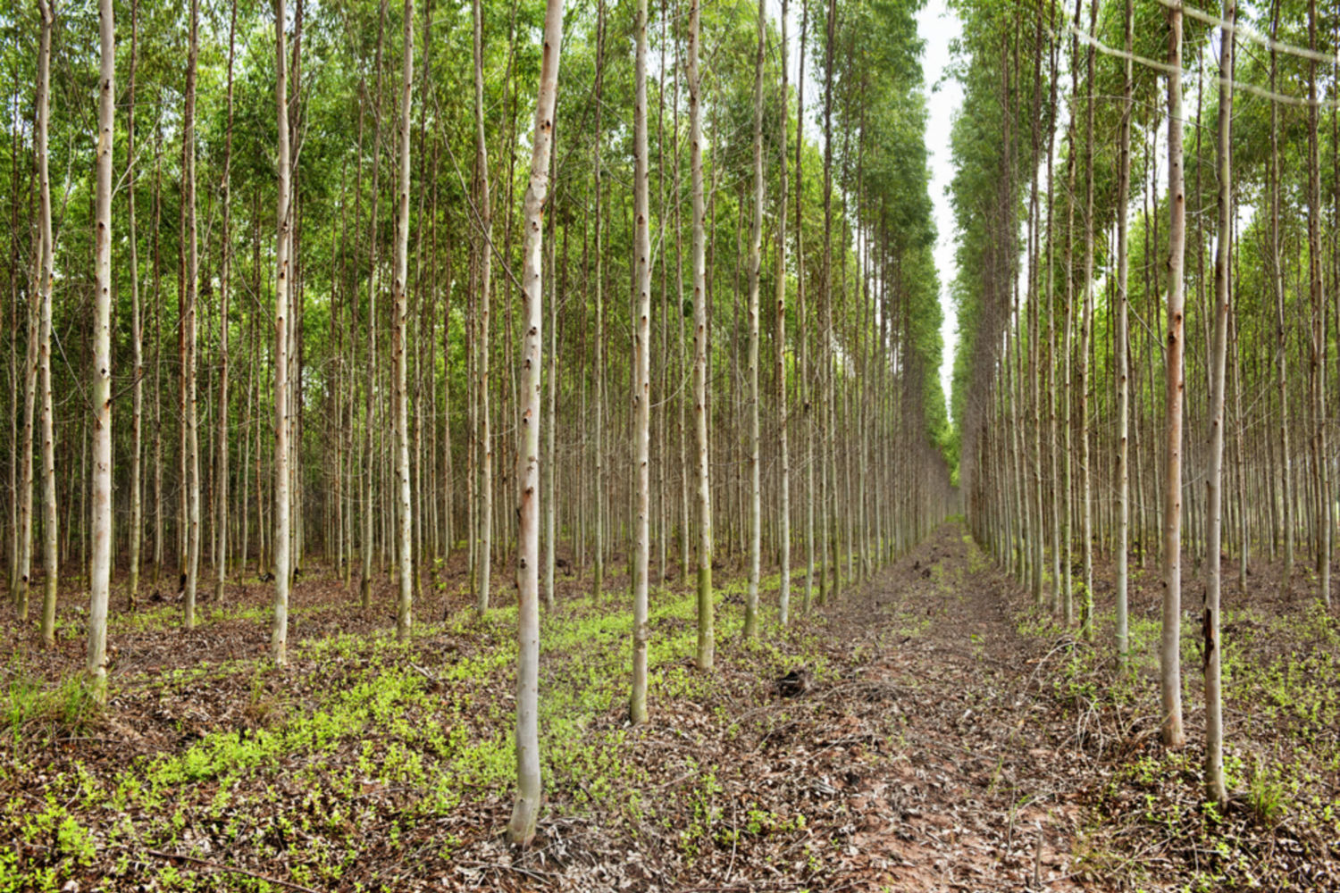
Nature-based Solutions is NOT
Tree-planting for climate mitigation using just one (non-native) species
Replacing natural ecosystems with species from another ecosystem (e.g. mangrove in sea grass fields, forest trees on a savannah
Uncoordinated small-scale projects and applications (e.g. greening city streets, green lines around dikes)

