Slide 1
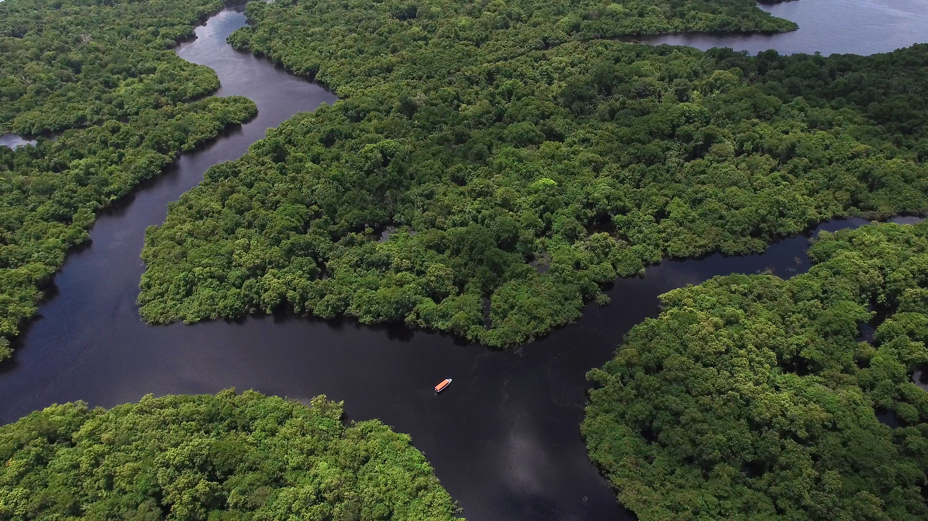
Locally owned solutions for thriving, climate resilient landscapes
Rosalien Jezeer
Tropenbos International
Nature Based Solutions for Climate Justice: concerns, roles and responsibilities
April 17th 2024
Notes:
REPLACE THE BACKGROUND PICTURE
DON'T ADD / REPLACE THE LOGO

Slide 2
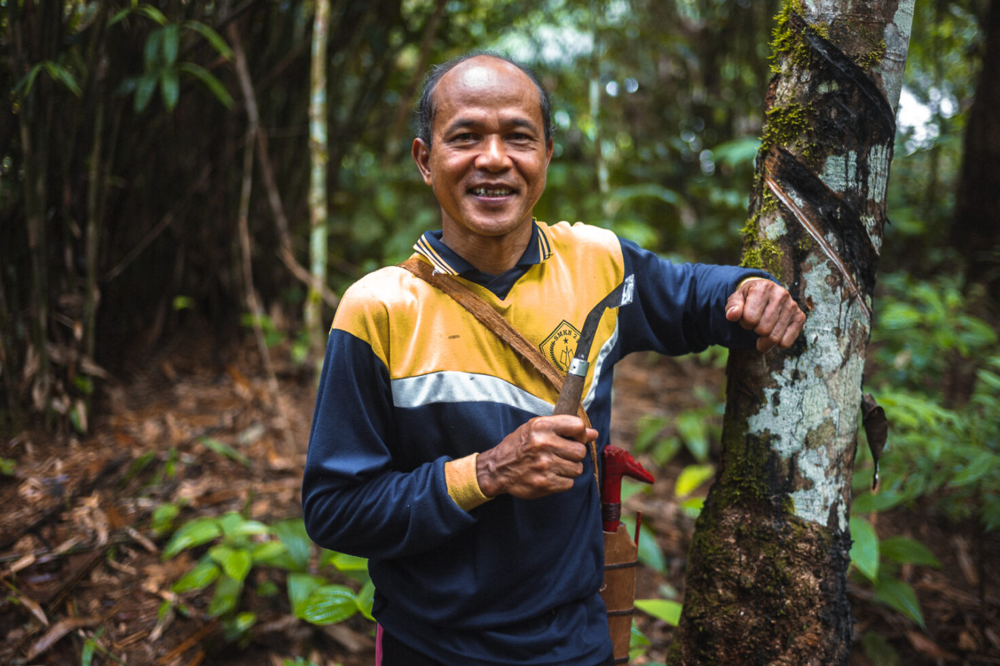
TBI applies a landscape approach
Local context is leading
Whose nature is it?
For whom provides it a solution?
Combining scientific and local knowlegde

Slide 3
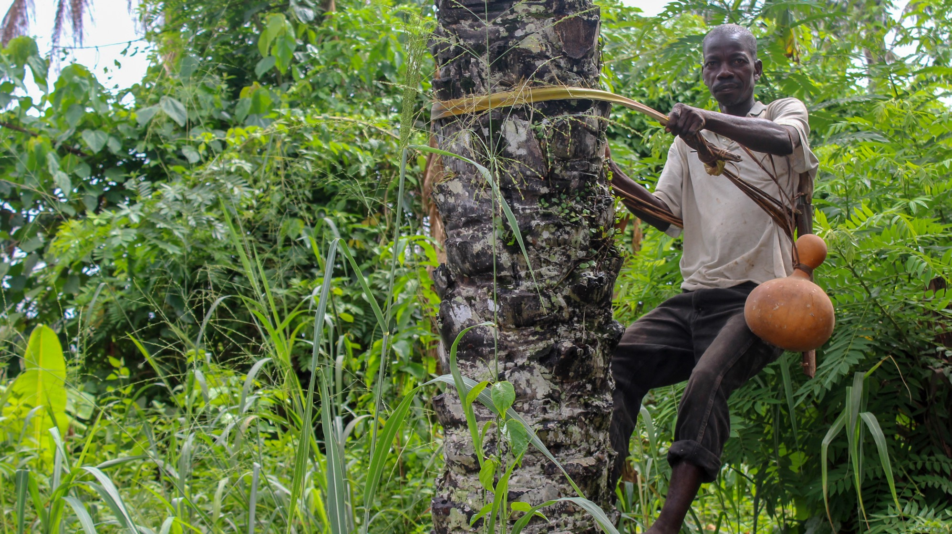
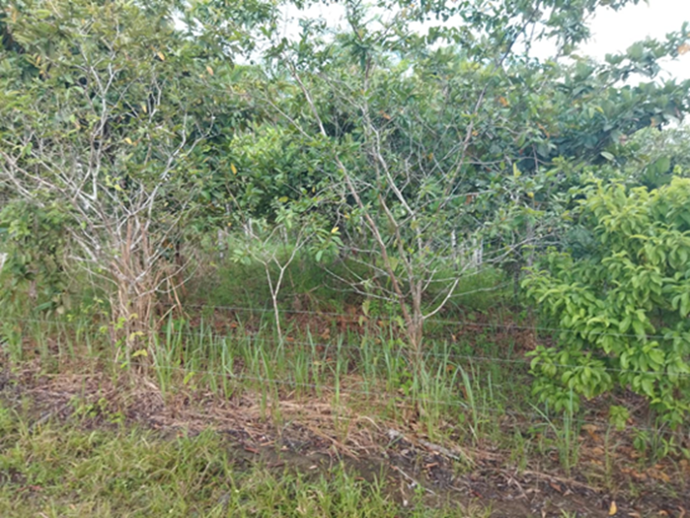
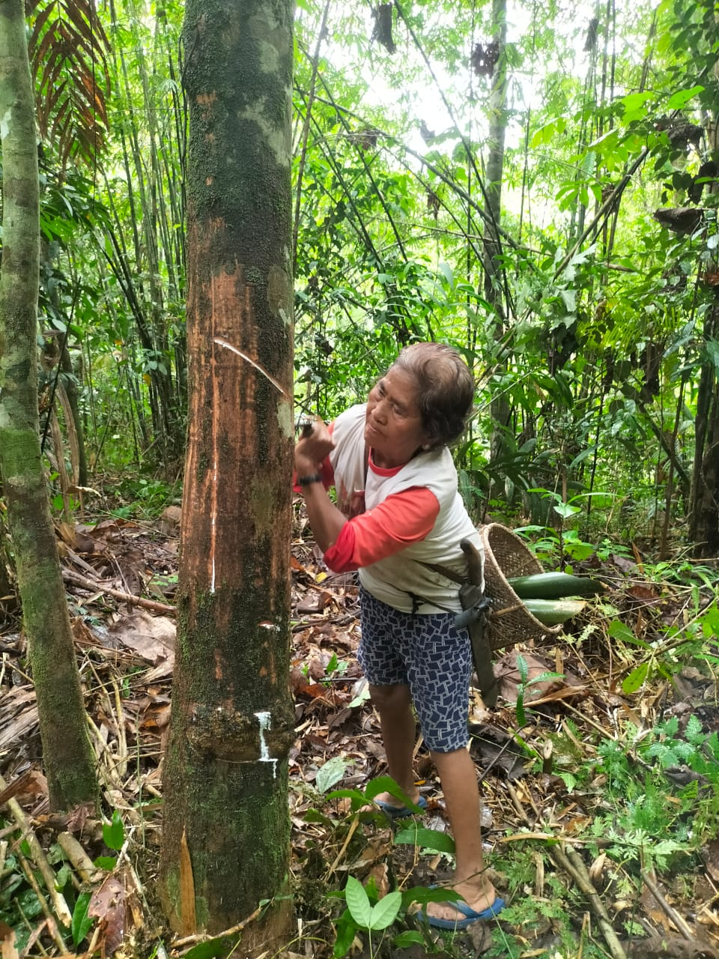
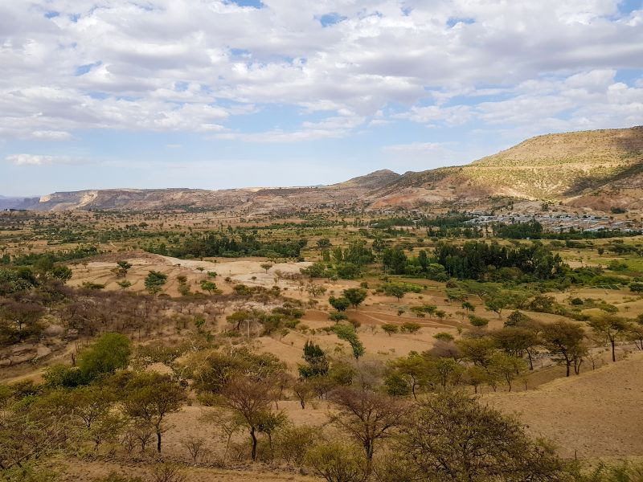
Participatory productive restoration in Colombia
Agroforestry systems in Ghana, Viet Nam and Indonesia
Developing a national dryland restoration strategy in Ethiopia

Slide 4

Tropenbos Indonesia_FINAL.mp4

